Slide 1

Game Maths & Physics
Matrices – Part 1

Slide 2
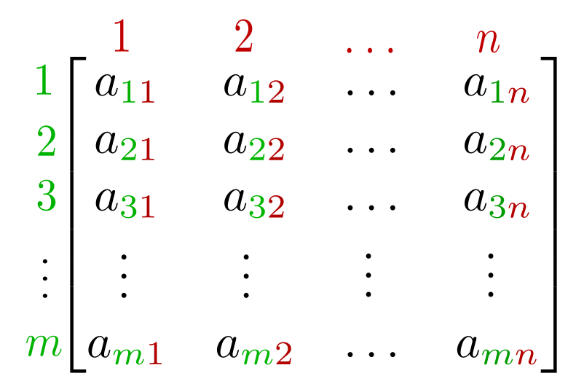
Matrices are used to:
Store structured information and numbers
Solve linear equations of any size
Manipulate vectors - Transformations

Slide 3
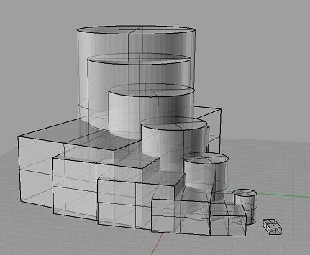
Transformations: Translations, Rotations, Scaling
Without them, everything would be the same size clustered at the origin

Slide 4
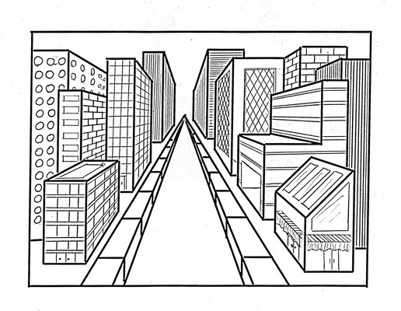
Transformations: Projection Matrices
Perspective view requires matrices to calculate the scale of objects in the distance

Slide 5
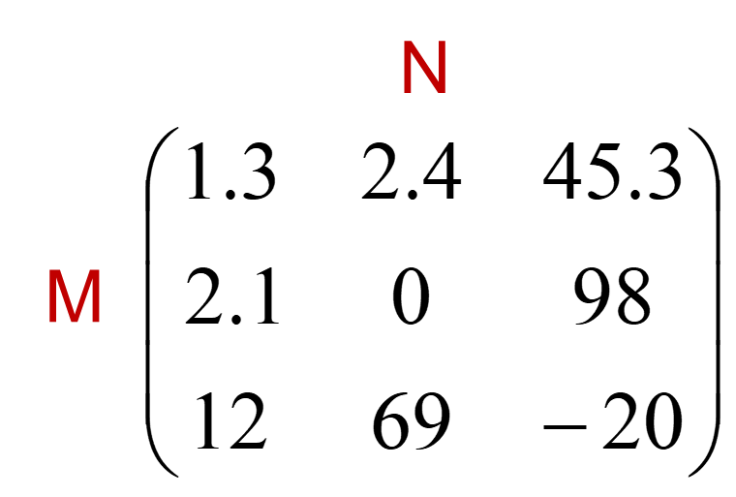
A matrix is a rectangular m x n array of numbers
m rows by n columns
If n = m, matrix is square

Slide 6
When written down, use square bracket [ ] to represent a matrix
Each number is call an entry. Each entry is denoted by its row and column location.
row 0 col 2
Matrix, A =

Slide 7
Number at row i and column j of matrix A is element
A_{ij}
/
Elements in row i make a row vector
Elements in column j make a column vector

Slide 8
A matrix with m rows and n columns is called
a matrix of order m x n
A square matrix is a matrix with an equal number of rows and columns. Since the number of rows and columns are the same, it is said to have order n m x n
The main diagonal of a square matrix are the elements from the upper left to the lower right of the matrix.

Slide 9

A row matrix is a matrix that has only one row.
A column matrix is a matrix that has only one column.
A matrix with only one row or one column is called a
vector

Slide 10
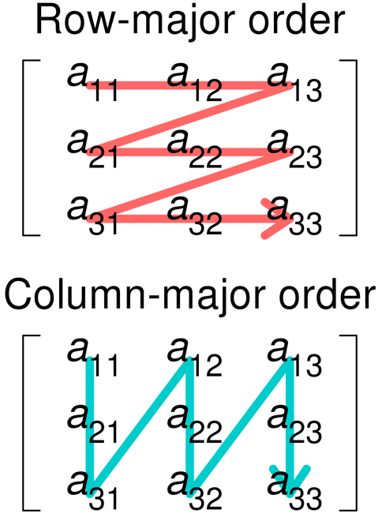
Row-major vs. column-major matrices
Specifies the order by which matrix elements are referenced.
When using a computer graphics or other matrix library, it is important to know if the matrix is row or column major order.

Slide 11
Two matrices are equal if and only if
The order (size) of the matrices are the same
The corresponding elements of the matrices are the same
==
0
!=

Slide 12
The Identity Matrix
Has these properties
Square matrix
1s on the main diagonal
0s everywhere else
Denoted by I
Any matrix times the identity matrix is the original matrix.

Slide 13
Matrix Operations
Addition
Order of the matrices must be the same
Add corresponding elements together
Matrix addition is commutative
Matrix addition is associative

Slide 14
A
A + B
Commutative
A+B = B+A
B
B + A

Slide 15
Matrix Operations
Subtraction
Order of the matrices must be the same
Subtract corresponding elements
Matrix subtraction is not commutative (neither is subtraction of real numbers)
Matrix subtraction is not associative (neither is subtraction of real numbers)

Slide 16
B + A
A
A - B
Not commutative
A-B != B-A
B
B - A

Slide 17
e.g. Find A+B and A-B

Slide 18
Scalar Multiplication
The matrix can be any order
Multiply all elements in the matrix by the scalar
Scalar multiplication is commutative
Scalar multiplication is associative

Slide 19
Matrix Multiplication
For matrix multiplication, the number of columns in A must equal the number of rows in B.
A_{PxQ} B_{QxR} = C_{PxR}
The two inside numbers must be the same
3 rows
2 rows
X
X
2 columns
3 columns
3
1
X
X
3
1

Slide 20
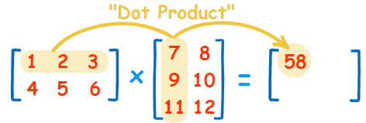
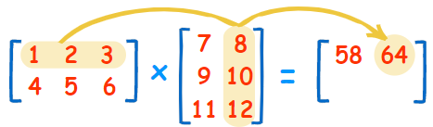
Each entry in the resultant matrix is determined by its location.
The entry is a single number that you find using the dot product of the corresponding row in the first matrix and corresponding column of the second matrix.
(1, 2, 3) • (7, 9, 11) = 1×7 + 2×9 + 3×11 = 58
(1, 2, 3) • (8, 10, 12) = 1×8 + 2×10 + 3×12 = 64

Slide 21
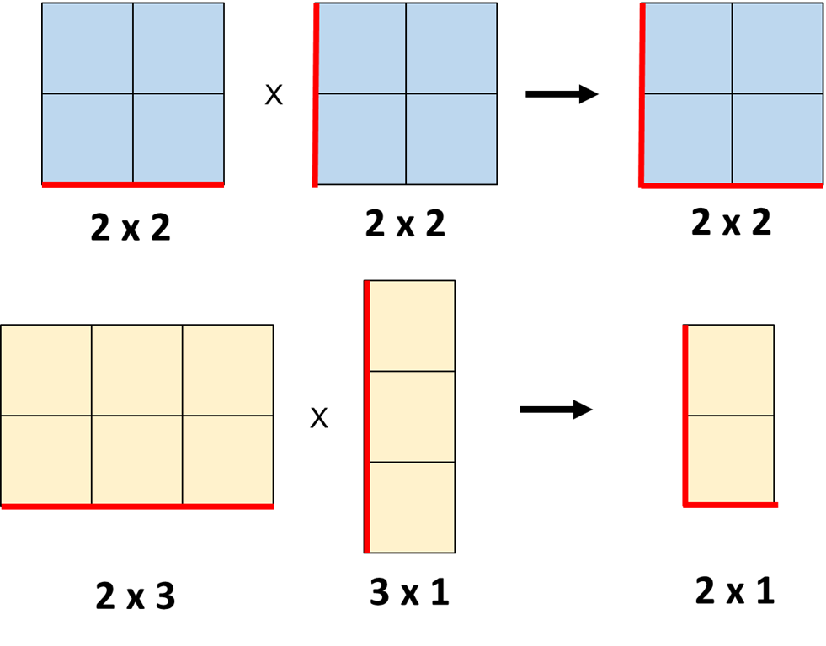
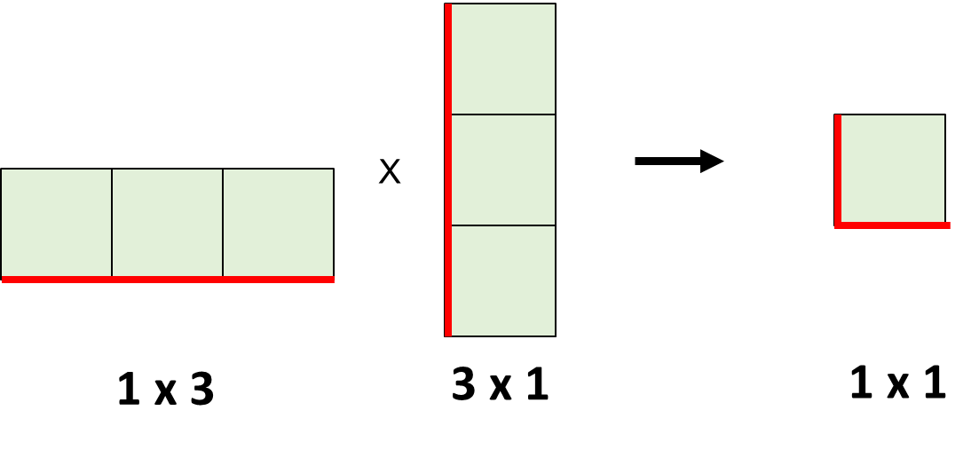
The two outside numbers is the size of the result
A_{PxQ} B_{QxR} = C_{PxR}

Slide 22
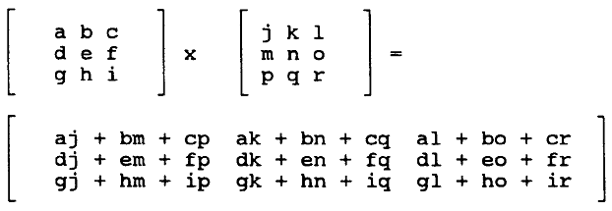

Slide 23
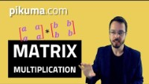
You should watch the rest after class (10m)
https://www.youtube.com/watch?v=Do_vEjd6gF0

Slide 24
Example 1

Slide 25
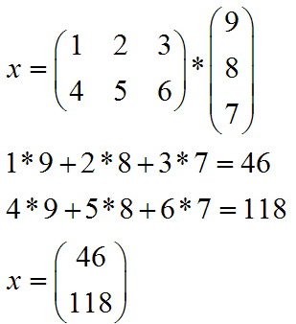
Example 2

Slide 26
If the two inside numbers are not the same, the product is not defined.
Inside numbers are not the same
Matrix Multiplication is NOT commutative:

Slide 27
Matrix Inverse
A⁻¹ is inverse of matrix A such that
Identity matrix
A⁻¹ reverses what A does
Only square matrices have an inverse
Inverse doesn’t always exist
Zero row, column means no inverse

Slide 28
Next slide …

Slide 29
Matrix Determinant
A single number formed from the entries of a matrix
2x2 matrix:
3x3 matrix:
The determinant has various important uses, which we won’t go into.

Slide 30
Same as Vector Cross Product (Sarrus’ Scheme):
ad - bc
aei + bfg + cdh – afh – bdi - ceg

Slide 31
Matrix Transpose
Transpose involves swapping each entry’s row and column.
Transpose symbol
Transpose can be applied to any size matrix.

Slide 32
Example
Transpose
Indicates that this is the transposed form of the matrix

Slide 33
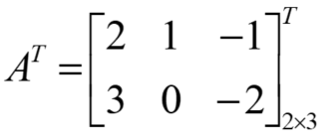
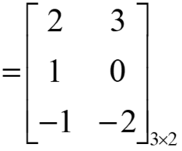
You can think of it as flipping a piece of cloth over, so that the back is now the front.

Slide 34
Matrices can be used to solve simultaneous equations
https://www.mathsisfun.com/algebra/systems-linear-equations-matrices.html
Do you remember this?
Solve the following equations for
x and y:
2x + y = 8
x + y = 6
We can rewrite in the form:
Excellent resource for all things math!

Slide 35


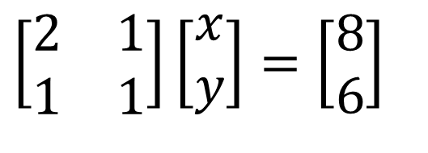
$$\left[\begin{matrix}2 & 1 \\ 1 & 1\end{matrix}\right]\left[\begin{matrix}x \\ y\end{matrix}\right]=\left[\begin{matrix}8 \\ 6\end{matrix}\right]$$
To “divide” by a matrix A, multiply by its inverse A⁻¹
$$\left[\begin{matrix}2 & 1 \\ 1 & 1\end{matrix}\right]$$
$$\left[\begin{matrix}2 & 1 \\ 1 & 1\end{matrix}\right]$$
Remember that:
A . A⁻¹ = I
And…
So …

Slide 36
Multiplying on both sides:
Why?

Slide 37
Check by substituting back:
2x + y = 8
x + y = 6
2(2) + (4) = 8
(2) + (4) = 6
Correct!

Slide 38
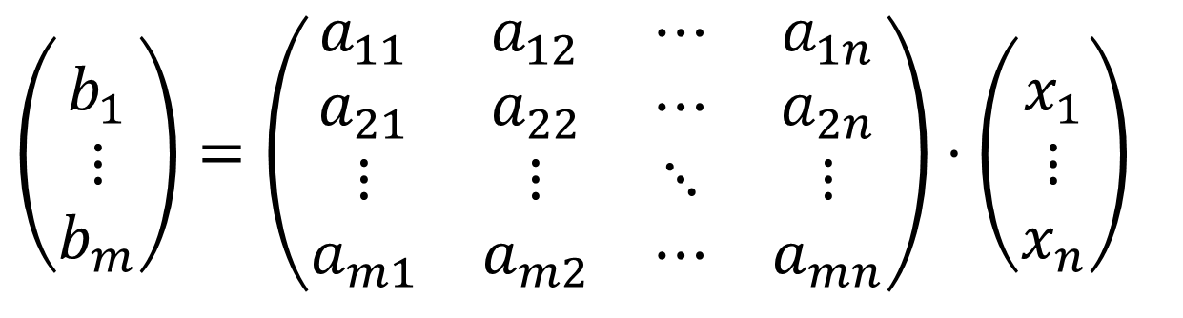
Define system of m linear equations with n unknowns
b₁ = a₁₁x₁ + a₁₂ x₂ + … + a_{1n} x_{n}
b₂ = a₂₁x₁ + a₂₂ x₂ + … + a_{2n} x_{n}
…
b_{m} = a_{m1}x₁ + a_{m2} x₂+ … + a_{mn} x_{n}
Matrix multiplication encapsulates linear system
$$\left(\begin{matrix} \\ b_{1} \\ ⋮ \\ b_{m}\end{matrix}\right)=\left(\begin{matrix}a_{11} & a_{12} & ⋯ & a_{1n} \\ a_{21} & a_{22} & ⋯ & a_{2n} \\ ⋮ & ⋮ & ⋱ & ⋮ \\ a_{m1} & a_{m2} & ⋯ & a_{mn}\end{matrix}\right)⋅\left(\begin{matrix} \\ x_{1} \\ ⋮ \\ x_{n}\end{matrix}\right)$$

Slide 39
Use matrices to solve large and complex systems of linear equations
Used in machine learning neural networks
Used in search and retrieval operations (Google uses HUGE matrices to compute search results quickly)
Used in computer graphics to draw polygons and pixels
GPUs are optimised for matrix calculations
Tensor cores are optimised for MASSIVE matrix calculations

Slide 40
Summary
Vectors and matrices are fundamental to mathematics and computer science.
You will usually use an existing library in your code to perform specific vector and matrix operations.
But it is essential that you understand how they are used in game development.
We have only just scratched the surface!

Slide 41
Now do Part 1 of your Matrices worksheet!

